Slide 1
The market: recent years

Slide 2
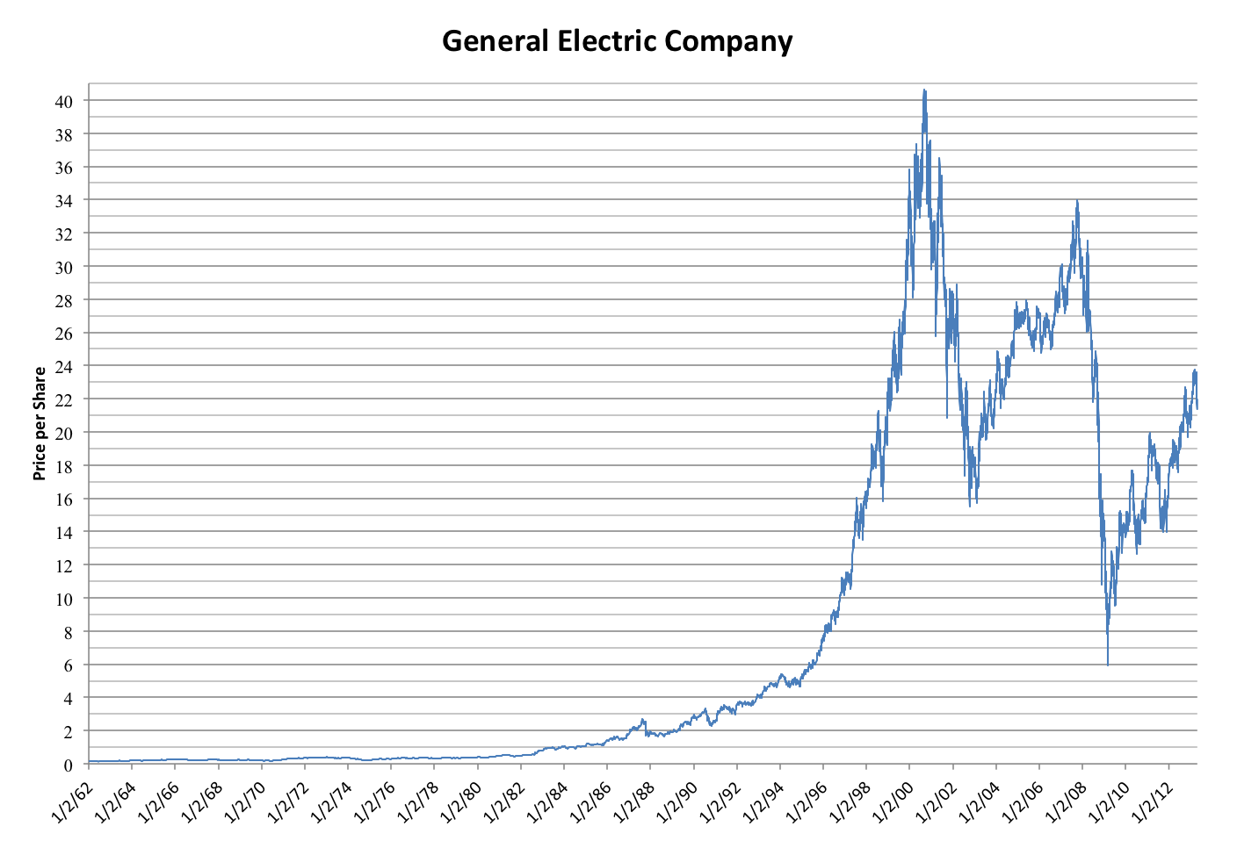
What makes a company good to invest in?
One or two words, what do we look at?
Do now: What is the difference b/t Technical Analysis/ Fundamental? (type in chat in < 3 words)
Notes:
Technicals?
Fundamentals?
Revenue?
Net Profit ?
Inventory?
Cash Flow?
Assets/Liabilities?
ESG?

Slide 3
What makes a company good to invest in?
One or two words, what do we look at?
What is a Technical Analysis? How does it differ from Fundamental? (type in chat in <3 words) - one is more TRENDS, other NUMBERS AND FACTS
Notes:
Technicals?
Fundamentals?
Revenue?
Net Profit ?
Inventory?
Cash Flow?
Assets/Liabilities?
ESG?

Slide 4
How to Invest
A deep dive of major players in the Market
Putting it all Together: How to survive/thrive in a pandemic
Notes:
Class 1 - 5Ws of Investing
vaccine race
the election’s impact
ETFs,
IPOs,
Mergers and Acquisitions,
Stock Split
Trade Wars

Slide 5
REVIEW from last class
Basics of Investing
How Stock Market works?
Analyzing Companies
Technical Investing
Fundamental Investing

Slide 6
We’ll look at:
APPLE
TESLA
GAMESTOP
MODERNA
ASTRAZENECA
What do they have in common? Not?
What do we take away from their mistakes? successes?

Slide 7
Format for today COMPANY (i.E. TESLA) i. Background ii. Technical Analysis iii. Fundamental Analysis iv. Summary

Slide 8
What does it do?
Technical Analysis
Fundamental Analysis
Apply Technical/Fundamental Analysis

Slide 9
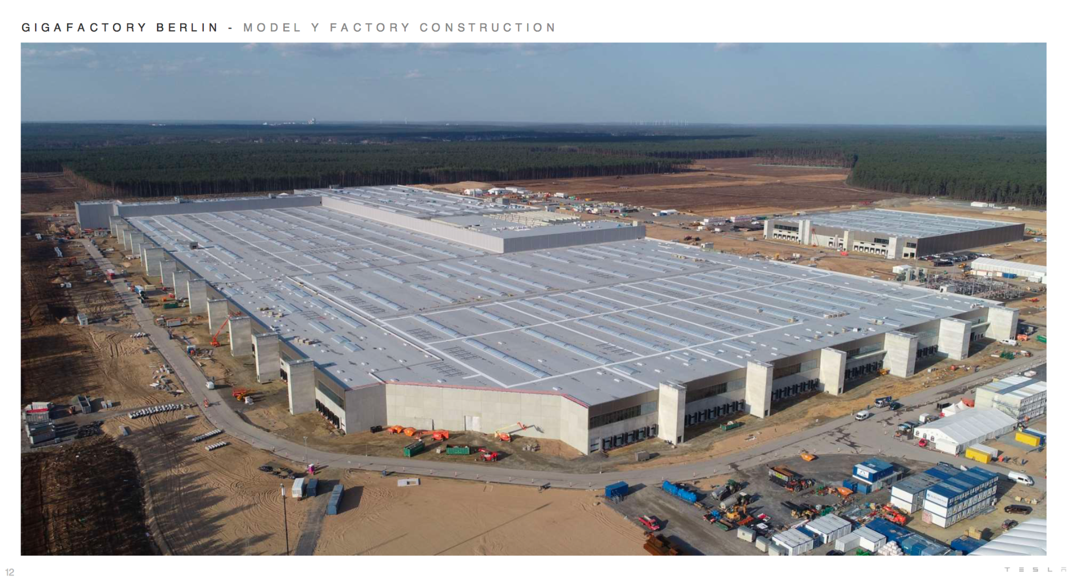
TESLA
Notes:
Is a company of this size important? What do you think?

Slide 10
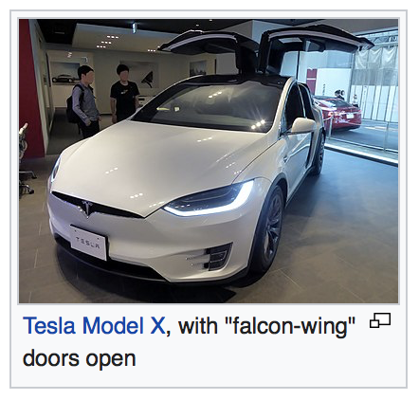
Tesla
Model
Solar Energy Device Installation & Electric Cars
Branding - Major Distributor of SE
CEO - Elon Musk
Value - Company of largest producer of non-gas fuel cars
Notes:
Quick facts

Slide 11
Key Question: Is Tesla better long or short term?
(time) Why is short term so low?

Slide 12
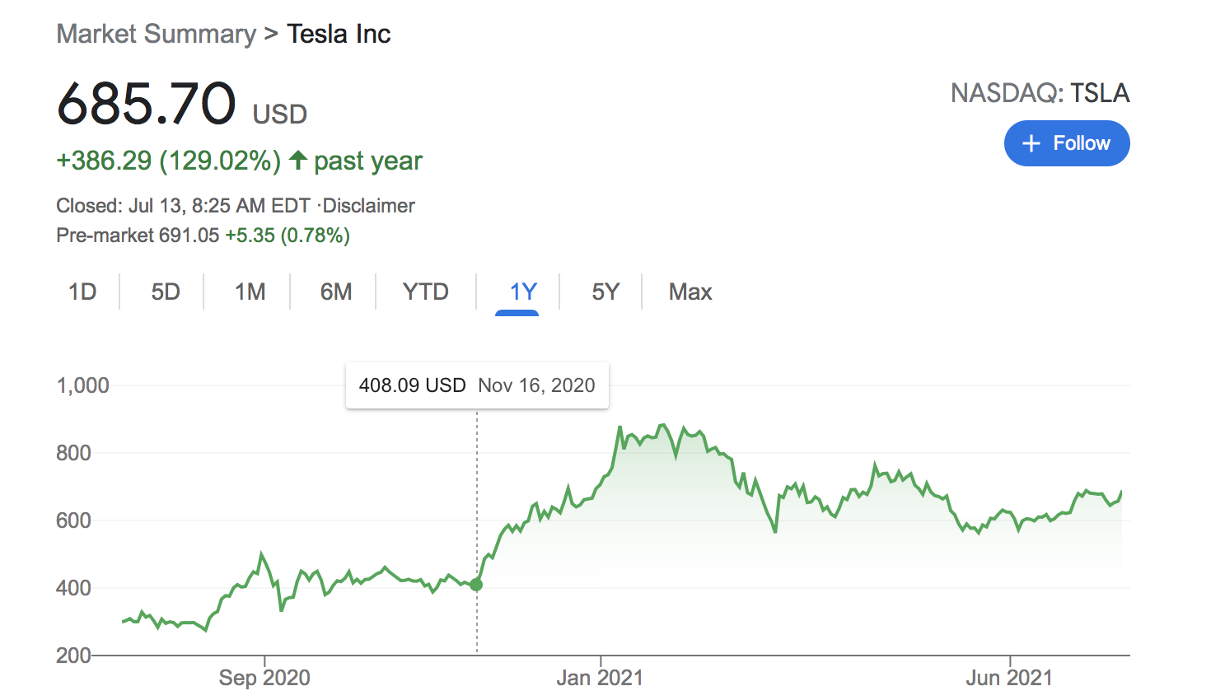
Technicals - Long Term
Increased by $300! (100% return)
Notes:
Good short/mid/long term
Which tesla best for?
Ignore light blue’’
What would your profit be in invested 1000 in 2020?

Slide 13
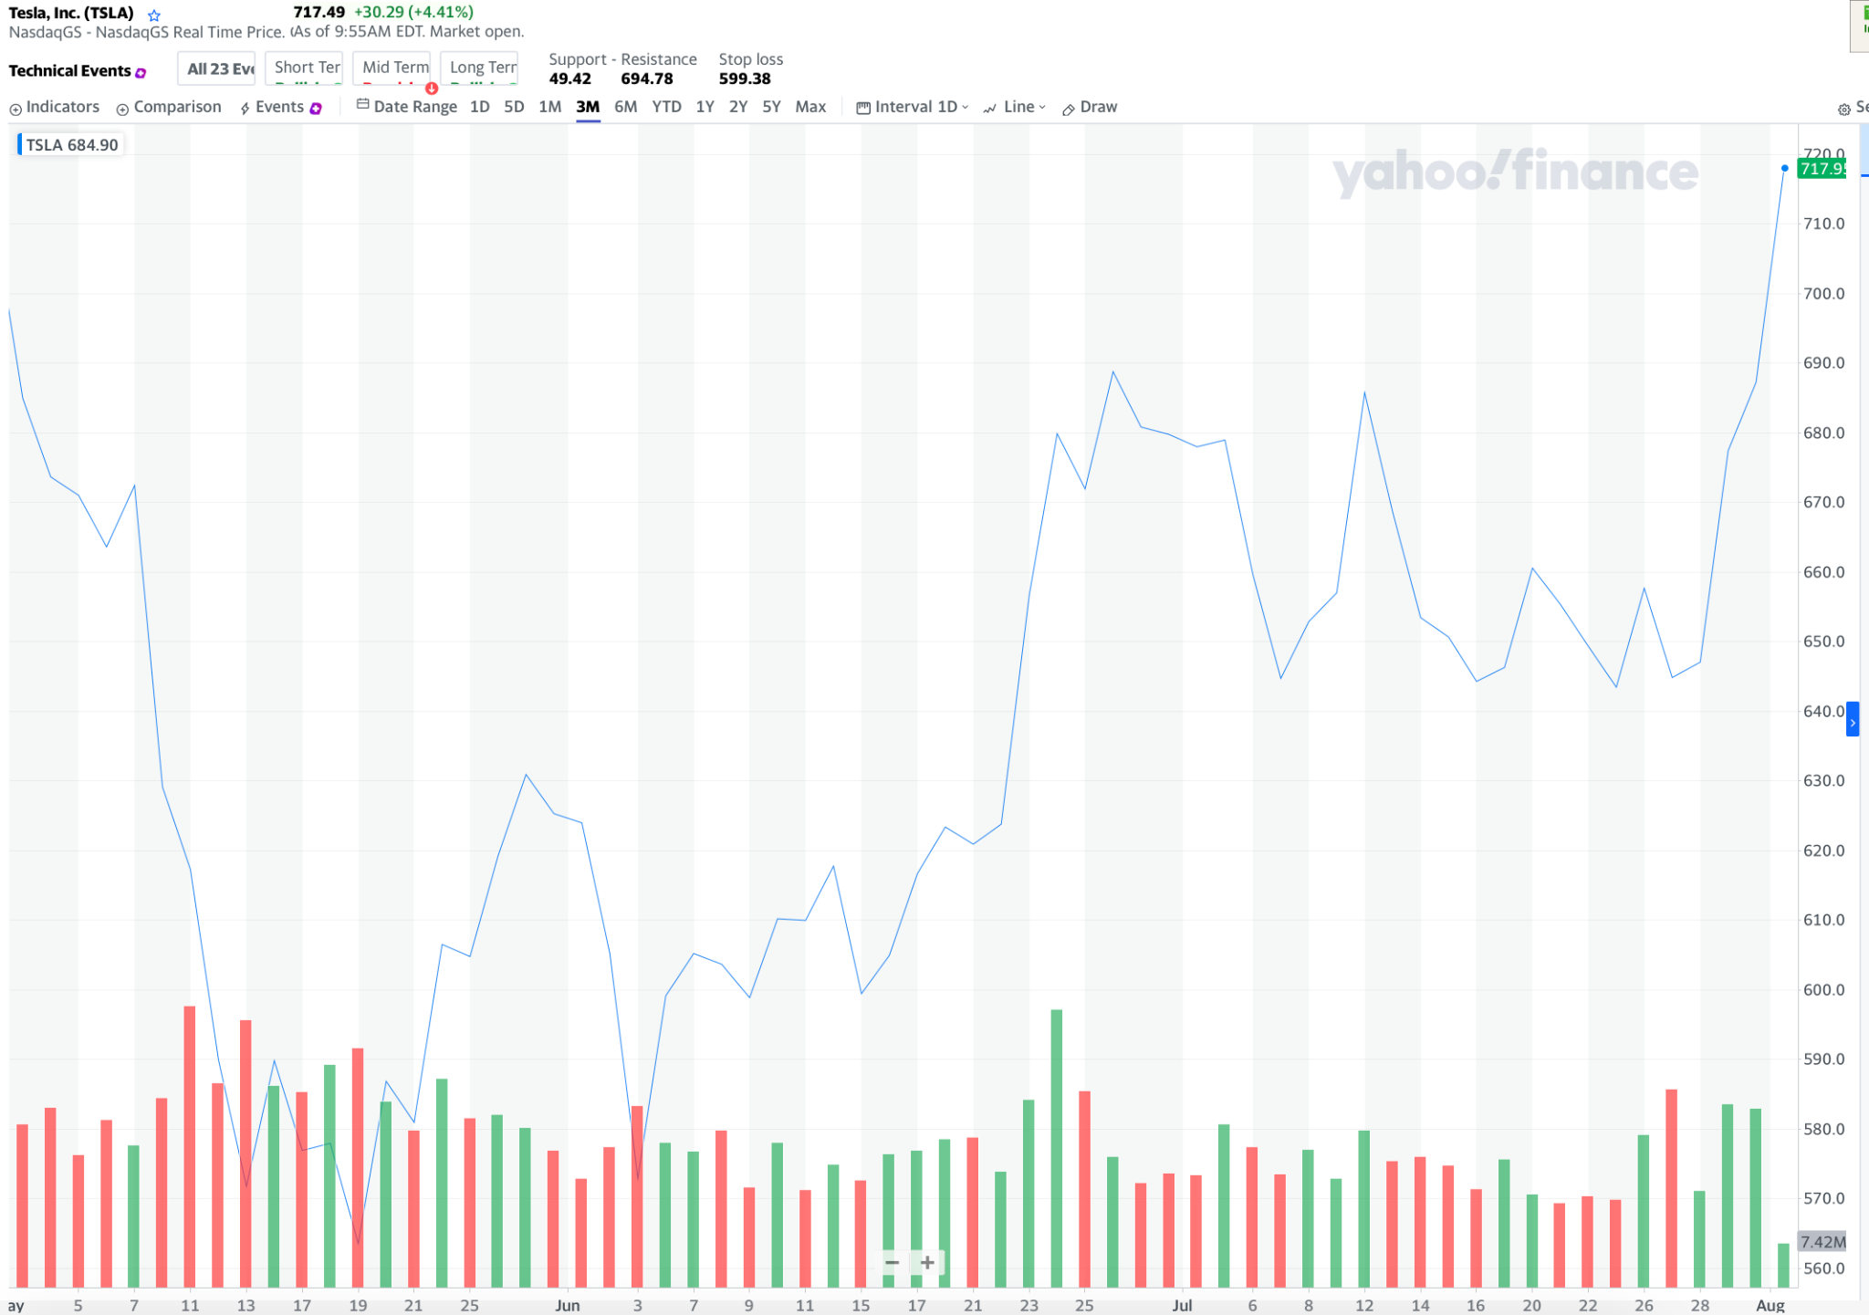
Short - Term
Price hasn’t changed as much...
Notes:
In 3month

Slide 14
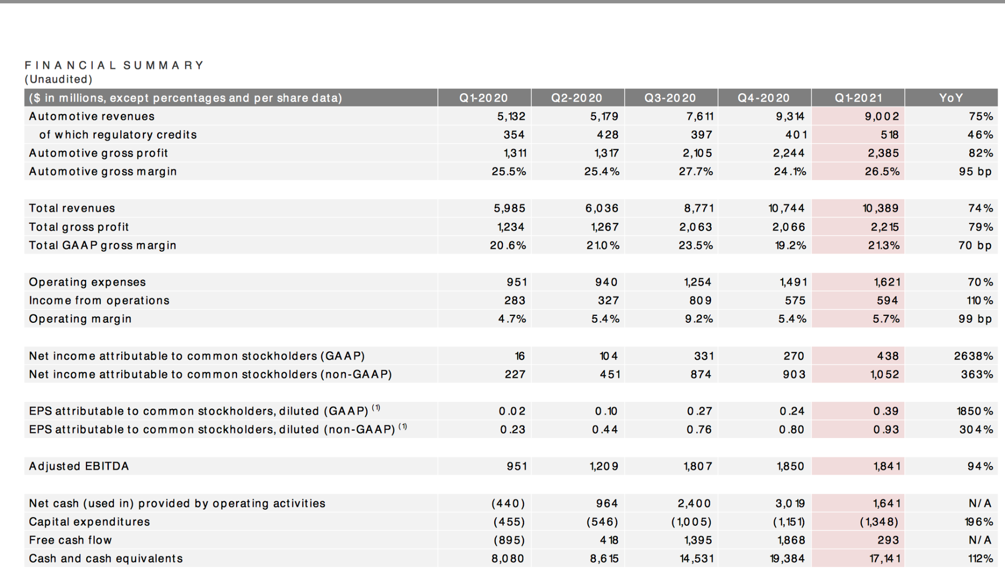
Fundamental (quantitative)
Notes:
Need to check for flags
Look rev/net income
Time permitting - EBIDTA and NET INCOME

Slide 15
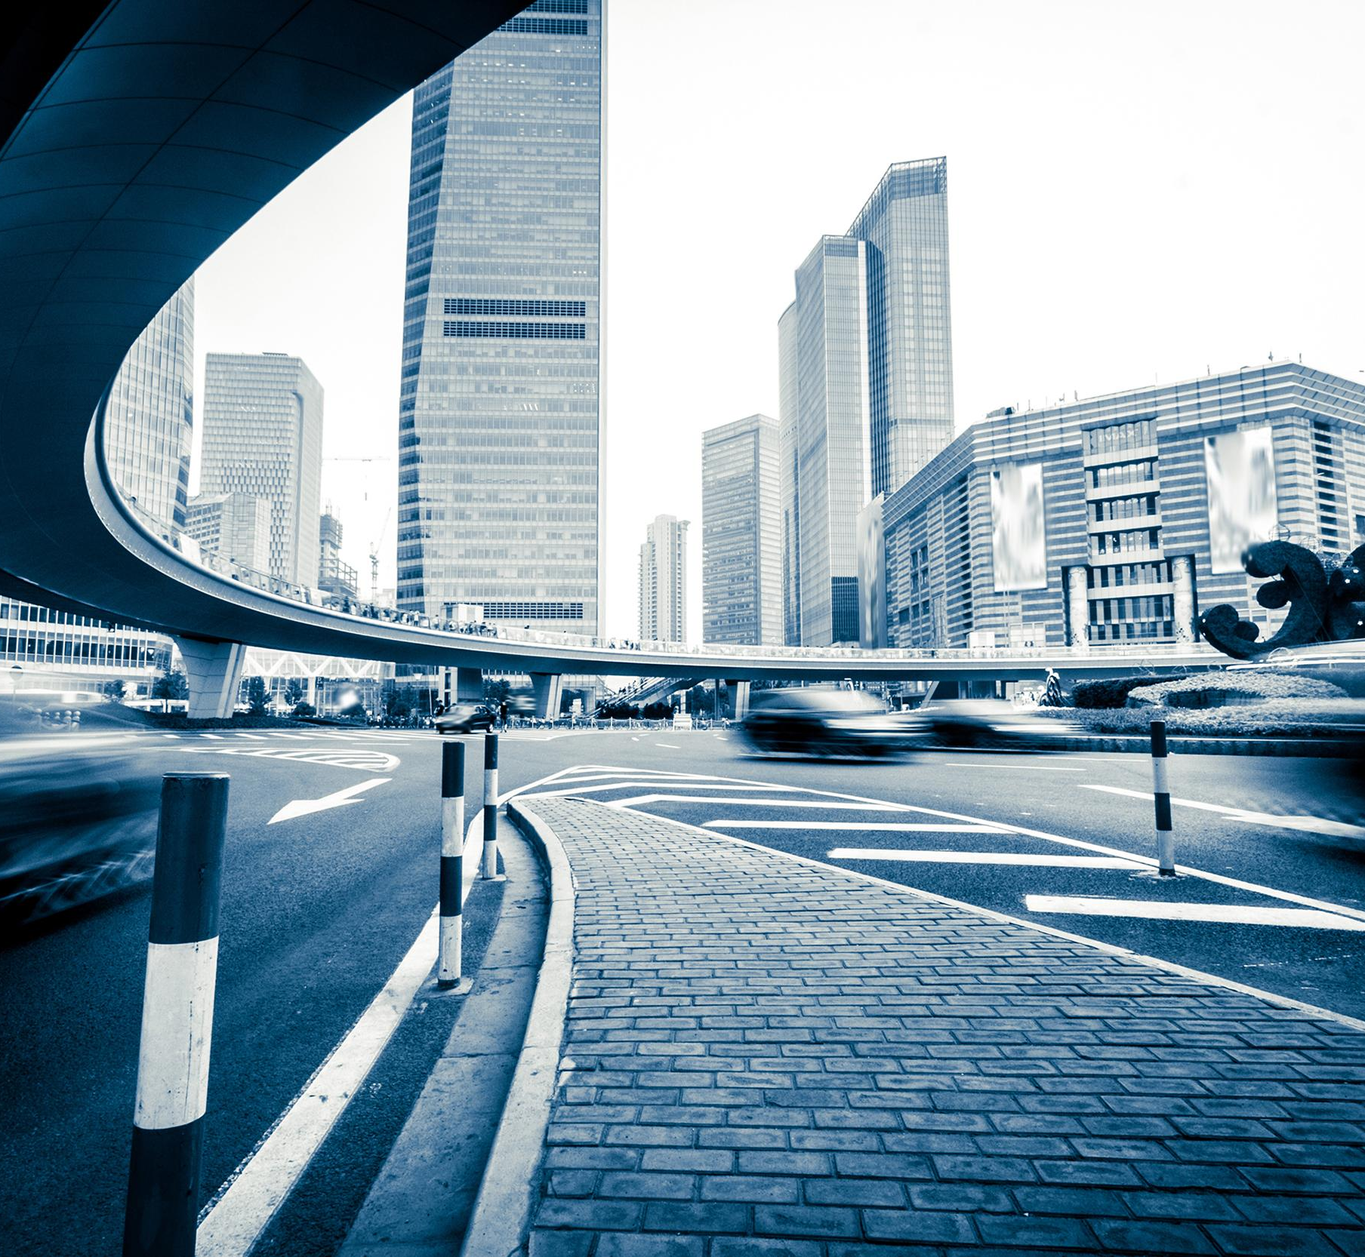
Is it a good company ? (qualitative)
Valuable products
International Philanthropy (donate)
Tesla also started its philanthropic effort in several places abroad (China, PR)
Notes:
Tesla also started its philanthropic effort. Tesla made multiple contributions of solar power to areas recovering from disasters in 2017, in particular installing a solar plus storage system to restore electricity at a hospital in Puerto Rico, following the destruction from Hurricane Maria.^{[40][41]} In July 2018, the company donated $37.5 million to kindergarten to 12th grade science, technology, engineering, and mathematics education in Nevada.^{[42]} In January 2020, Tesla donated 5 million Yuan ($723,000) to the Chinese Center for Disease Control and Prevention to fight the COVID-19 outbreak.^{[43][44]}

Slide 16
Cont.
Electric Vehicles
Solar energy panel
a trend for “clean energy”
Fun Fact - Forerunner for AI Cars
Can drive themselves; the project was deemed unusable but may generate more ai interest?
Notes:
1st candidate
Society still runs mostly on gas -> probably why it isn’t emphasized
How generated?

Slide 17
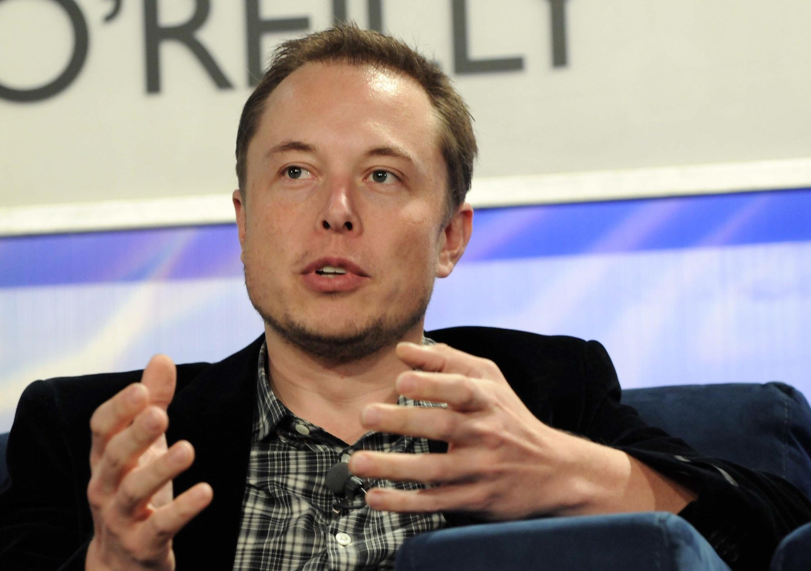
The Controversies
> Shortage of demand (mostly from China)
> Supply disruption because of pandemic
> Competition from EV
Notes:
https://en.wikipedia.org/wiki/Tesla,_Inc.
What does private mean? What happens to investo
Why did it go up or down?
He raised expectations for price to go up soon
Last chance to get the stock
It was a lie: so it was pointless
Tesla: bad Reputation
Tesla - valuable company popular for its controversies
When a company says this, you might want to buy stock because its your last chance - hopefully, not lies
- -- -
If private, last change to become investor - so ppl invested a lot; but it was a lie, - waste of time and money
Tesla public image - seen using marijuana
Misleading claims about self-driving
Takeaway - do your research ; ensure that you

Slide 18
Pros and cons
Pros
working on clean energy products
- philanthropic causes
sound technical/fundamental
Cons
major controversies - involving both companies or CEO
Should one invest or no?
Notes:
Do some research; but seems solid

Slide 19
Apple
Sells computer equipment and software
High quality brands - Ipads, iphones, watches, macs?
Notes:
Include talk about latest brands
Who doesn't own apple
-- like tesla, has its controversies

Slide 20
Apple
most valuable - first company to reach 1 trillion dollars in MC (the Harvard of companies)
CEO: Tim Cook
Notes:
Include talk about latest brands
Who doesn't own apple
-- like tesla, has its controversies

Slide 21
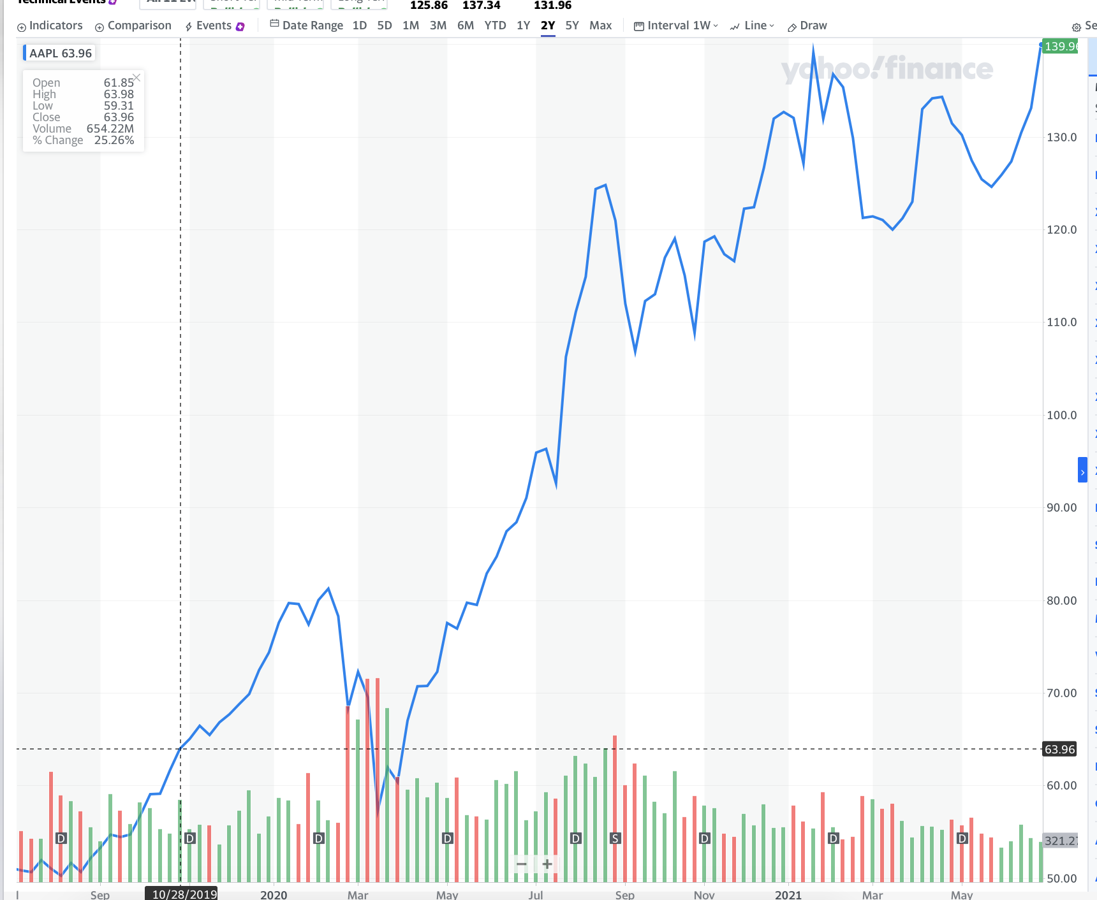
Technical Investing
Notes:
Technically speaking, linear increase for year, only now looks like its been stagnate; Not hard to see an increasing trend
Apple mirrors the economy pretty well (if economy up then apple and vice)
Growth is slow
Not volatile
Is OK, but best
Short term vs long term Vs midterm
Short- term stagnate
Mid-term stagnate
Better for long term; not short/middle
Looks like it will grow
Look at the patterns
Small chance it wont (overvalued)?
Where do you think price will go?
Profit if invested 2020

Slide 22
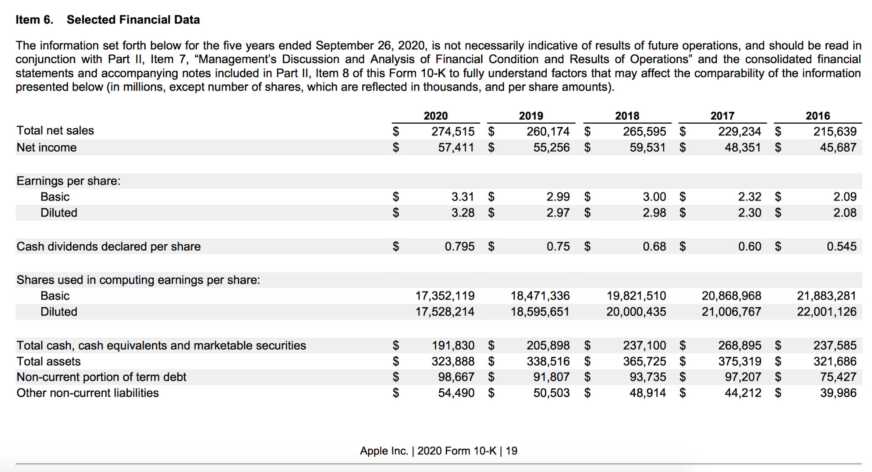
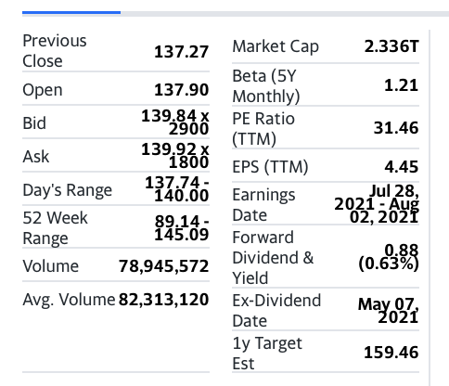
Notes:
Each category has linear / stable trend
What are the trends you guys see in this chart?
No red flags

Slide 23
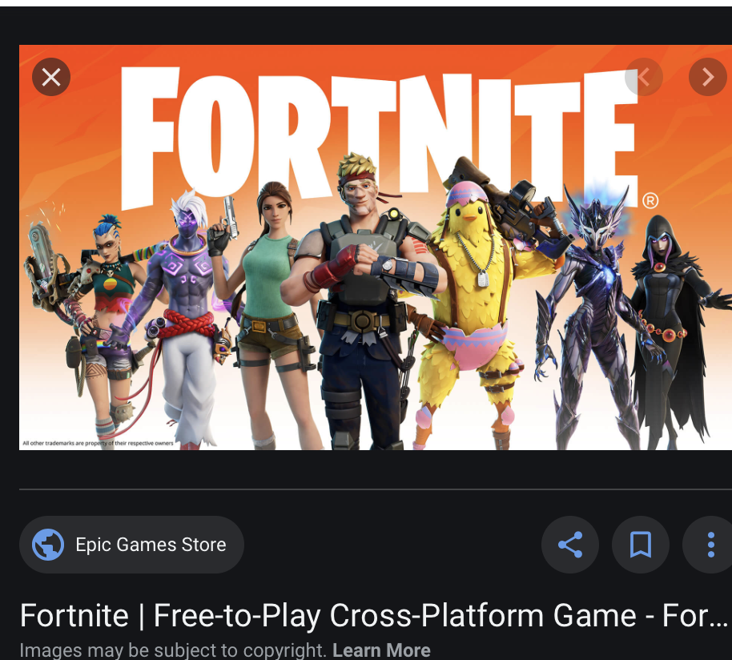
Controversies (notable) - time permitting
Apple Store Fee Collection
Notes:
3rd person shooter game, play up to 99 other people
Lashback from EPIC games,
More than 2bn taken from epic games possibly? Is this ok?
Collected high fees - true possible for other apps

Slide 24
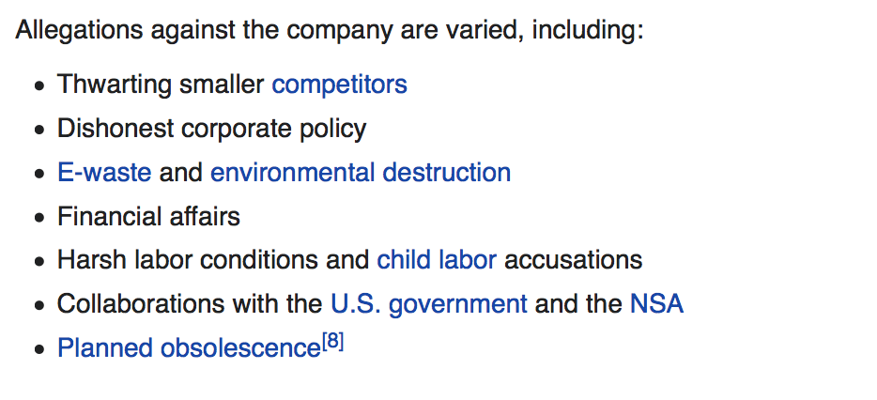
Cont
All available on WIKI
Notes:
Other accusations include:
Easily
Is it a monopoly? Should apple be dealt with? What will the outcome be?

Slide 25
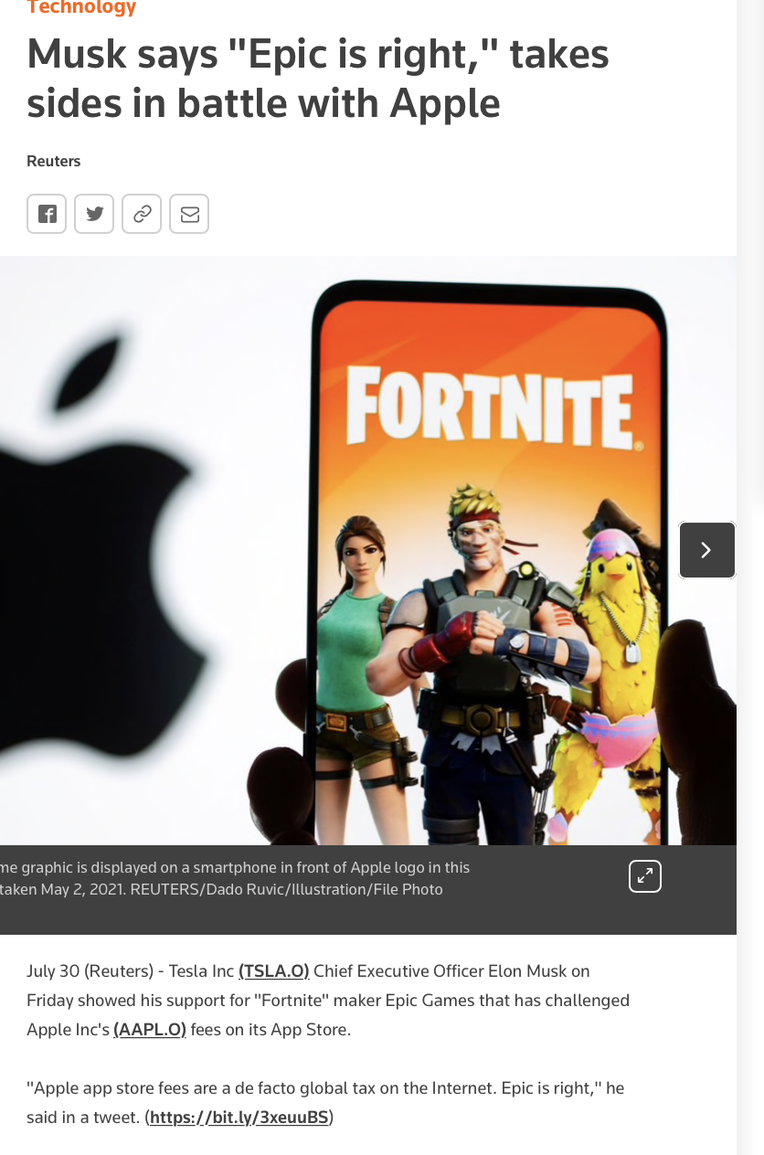
Notes:
Global tax on internet

Slide 26
Gamestop
Biggest seller of video games
Fell in price because shift in downloads and online
Many games like xbox can be downloaded directly
Reached a plateau in rev;
See bottom

Slide 27
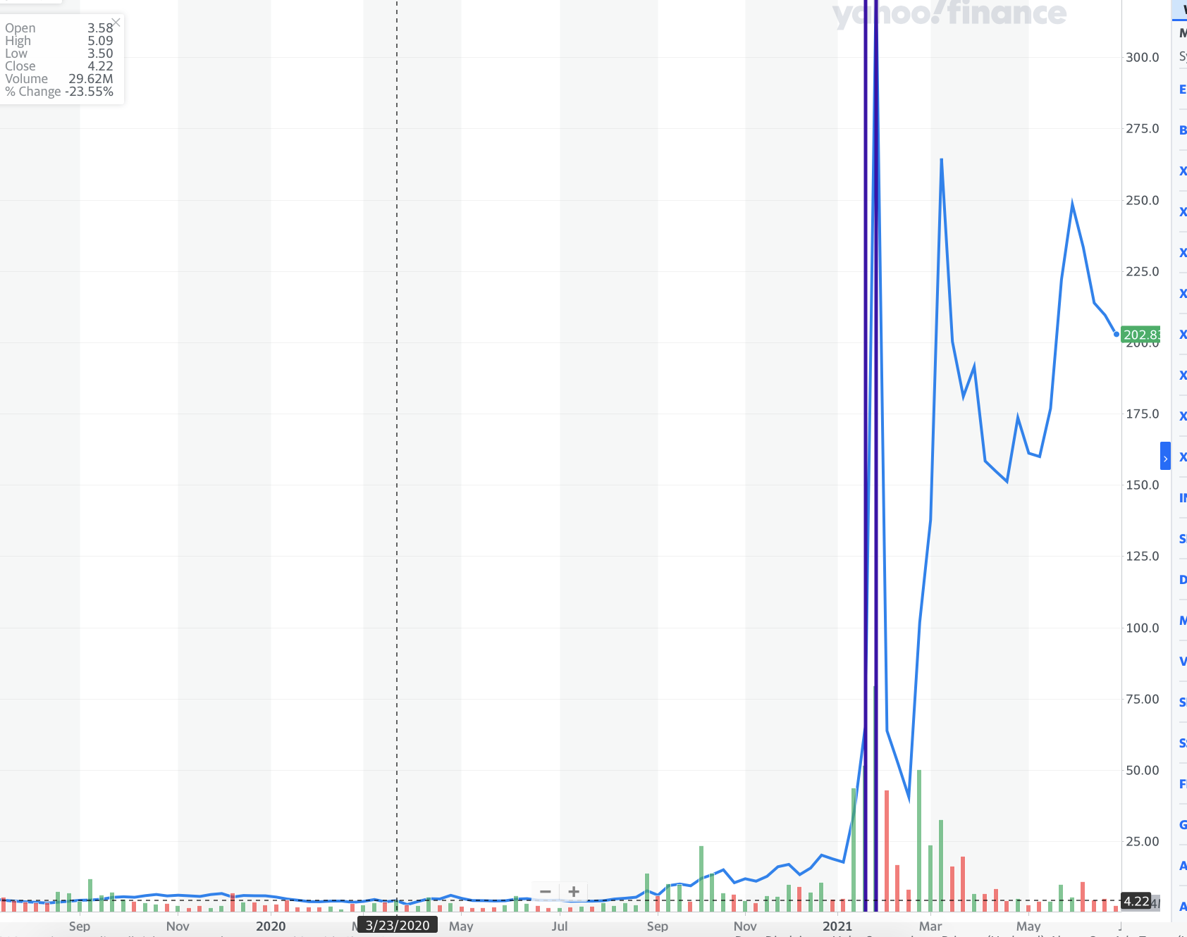
TECHNICALS
Notes:
Until 2020, price stayed low

Slide 28
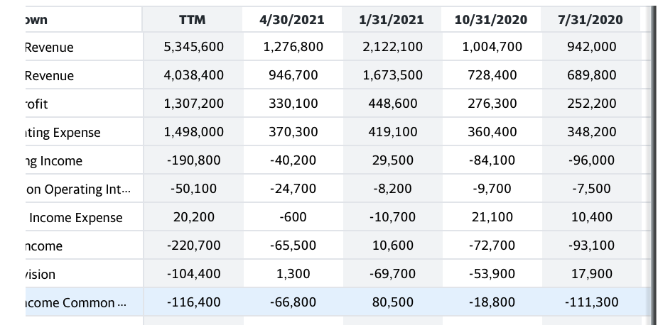
Notes:
Hmm…
Net income is unstable
/ as is revenue
Revenue is also a bit unstable

Slide 29
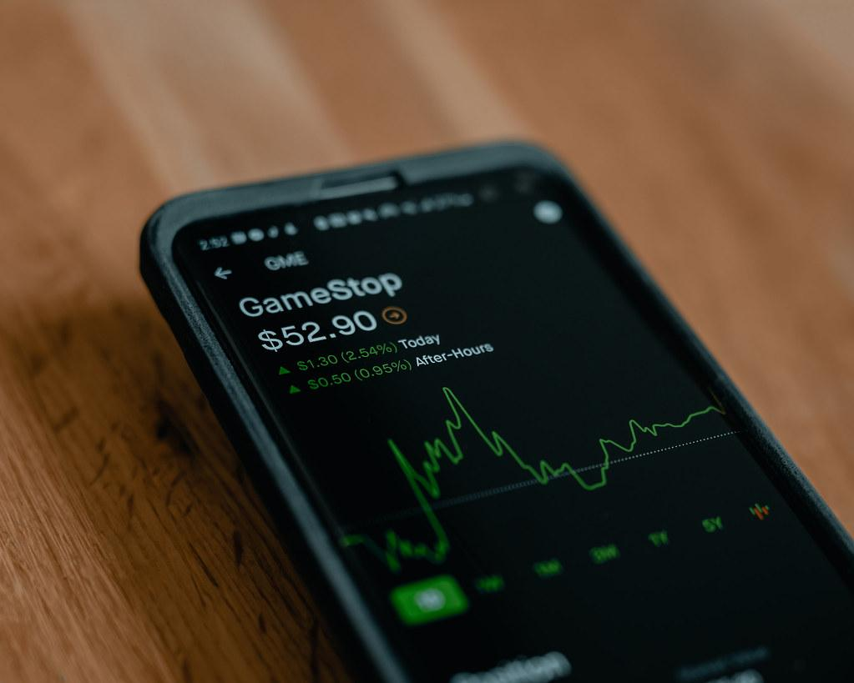
A Turnaround -What?
a bunch of people bid up price of gamestop;
What is it called when people inflate the price of stock?
Hurts hedge funds betting against gamestop & also Robinhood
Share ownerships reduced on Robinhood to stop the spike
Notes:
Market manipulation - the intentional raising or falling of price due to people buying/selling in bulk
Causes people to buy and sell panickedly

Slide 30
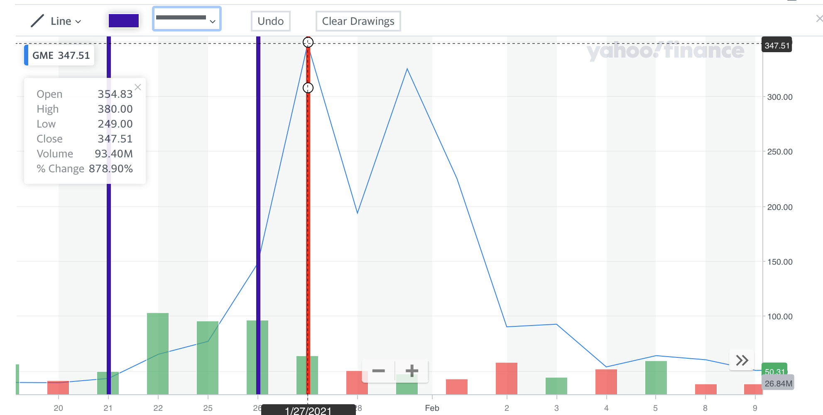
Notes:
What was the price increase from Jan 26-27; Climbed from 150 to 347; to the nearest tens, what was the increase?
350-150 =

Slide 31
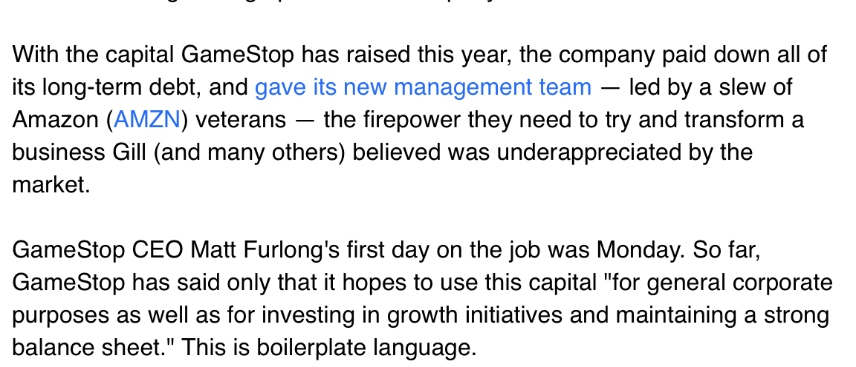
Company in June 2021
Notes:
From yahoo news
And nows there a trickle effect
Company saved fr!!!
Will GameStop will grow? Can we trust the new amazon team? If same strategy, maybe bad???

Slide 32
Gamestop
Business model: sale of video games / other tech products
CEO: Matt Furlong (Jun 21, 2021–) (from Amazon)
Strateg(ies) (2020)

Slide 33
Can we trust GME? What do you think?
Pros
Paid long-term debt
New leadership (CEO)
Cons
questionable business model
most games can be downloaded NOT in-person

Slide 34
Takeaways
-> it was so short…(lasted ~2 days)
really easy to have lost money then have gained:
-> market is not robotic
ppl ALSO invest in what they care for (games); not just money (unlike Apple/Tesla
-> observ:
the market is truly powerful (who knows how many people traded in it?)
Notes:
And unlike with APPl

Slide 35
Discussion Question (choose 1 or 2)
> you are a stock market regulator: what’s one step to prevent market manipulation?
> how can investing be used as a tool for societal change?
> How this company is different from Tesla/Apple?
> Do you think more ppl suffered? Or gained?
Notes:
Is Gamestop over/undervalued?
Answers in the chat

Slide 36
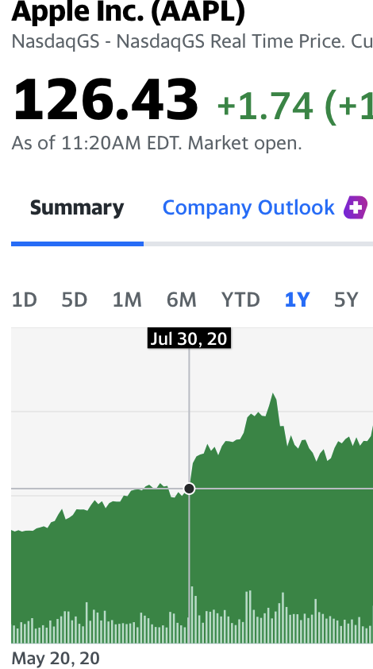
Apple
Same time - Increased by ~50%
Whether you had bought 5 shares of apple
At $120 or 1 share of tesla at 600, Your percent increase
Is still ~50%
It didn’t matter which one you got into;
Notes:
Had a similar % increase (~50%) if you had bought 4 shares or apple or 1 share of tesla,
People were mindlessly sort of investing in both apple and tesla, without researching either
Increase is around $200
Like tesla, price fell right after (Overvalued)
Move to appendix

Slide 37
The market pt2: 2020-2021
(Vaccine Race, Energy, Industrials)

Slide 38
Healthcare and the stock market?
Notes:
Healthcare field relies a lot on money to function -
In fact, it is estimated to take around 1.3bn on average to develop a drug
Most of the money needed to fund the drug trials
High valued field in society (looking at pandemic, job need, etc.)
Looking at the health-field, particular role of vaccine companies

Slide 39
HC Company by Revenue
1. Johnson & Johnson – $56.1bn (companies by revenue)
2. Pfizer – $51.75bn
3. Roche – $49.23bn
4. Novartis – $47.45bn
5. Merck & Co. – $46.84bn
6. GlaxoSmithKline – $44.27bn
7. Sanofi – $40.46bn
8. AbbVie – $33.26bn
9. Takeda – $30.52bn
10. Shanghai Pharmaceuticals Holding – $26.69bn
Vaccine Race
In 2020, more than 20 companies racing to create a vaccine
Who won (FDA - emergency use approval) for vaccine?
Moderna, JNJ, Pfizer & BioNTech
Notes:
The global pharmaceutical industry is expected to witness positive growth as the top pharma companies are at forefront of the fight against COVID-19.
From Johnson & Johnson to Shanghai Pharmaceuticals, Pharmaceutical Technology lists the top ten pharmaceutical companies in 2020, based on revenues.
The world’s biggest pharmaceutical companies: Top ten by revenue
1. Johnson & Johnson – $56.1bn
2. Pfizer – $51.75bn
3. Roche – $49.23bn
4. Novartis – $47.45bn
5. Merck & Co. – $46.84bn
6. GlaxoSmithKline – $44.27bn
7. Sanofi – $40.46bn
8. AbbVie – $33.26bn
9. Takeda – $30.52bn
10. Shanghai Pharmaceuticals Holding – $26.69bn

Slide 40
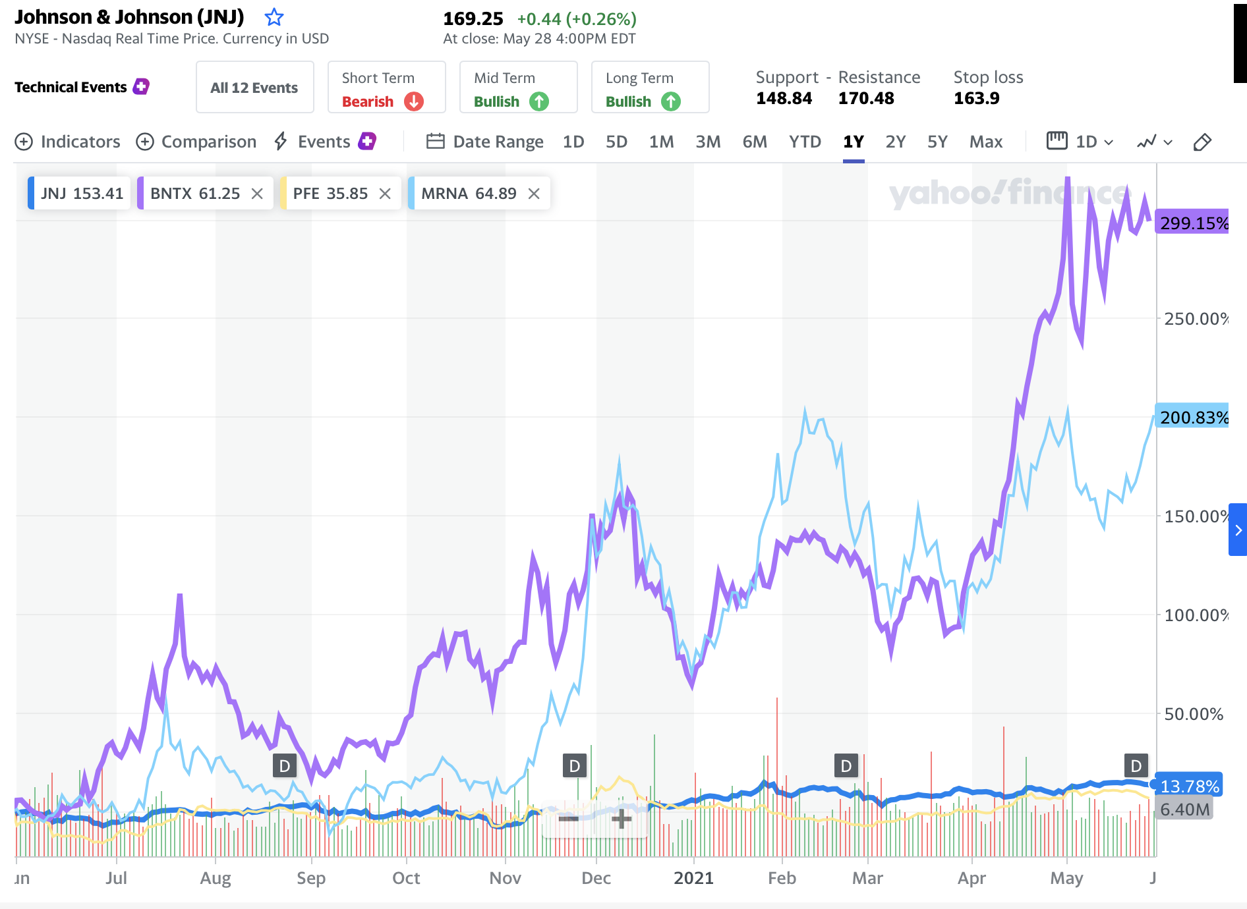
A look at the winners (to june)
Notes:
Who winning, who is losing?
Why doesn’t pfizer move?
Why is biontech higher than moderna ?
Not sure, would have to look at april news for last question
Why does JNJ stay still? Now
66% protective against moderate to severe Covid infections
measured overall from 28 days after injection; which is much different than the other vaccines.
https://www.statnews.com/2021/02/02/comparing-the-covid-19-vaccines-developed-by-pfizer-moderna-and-johnson-johnson/

Slide 41
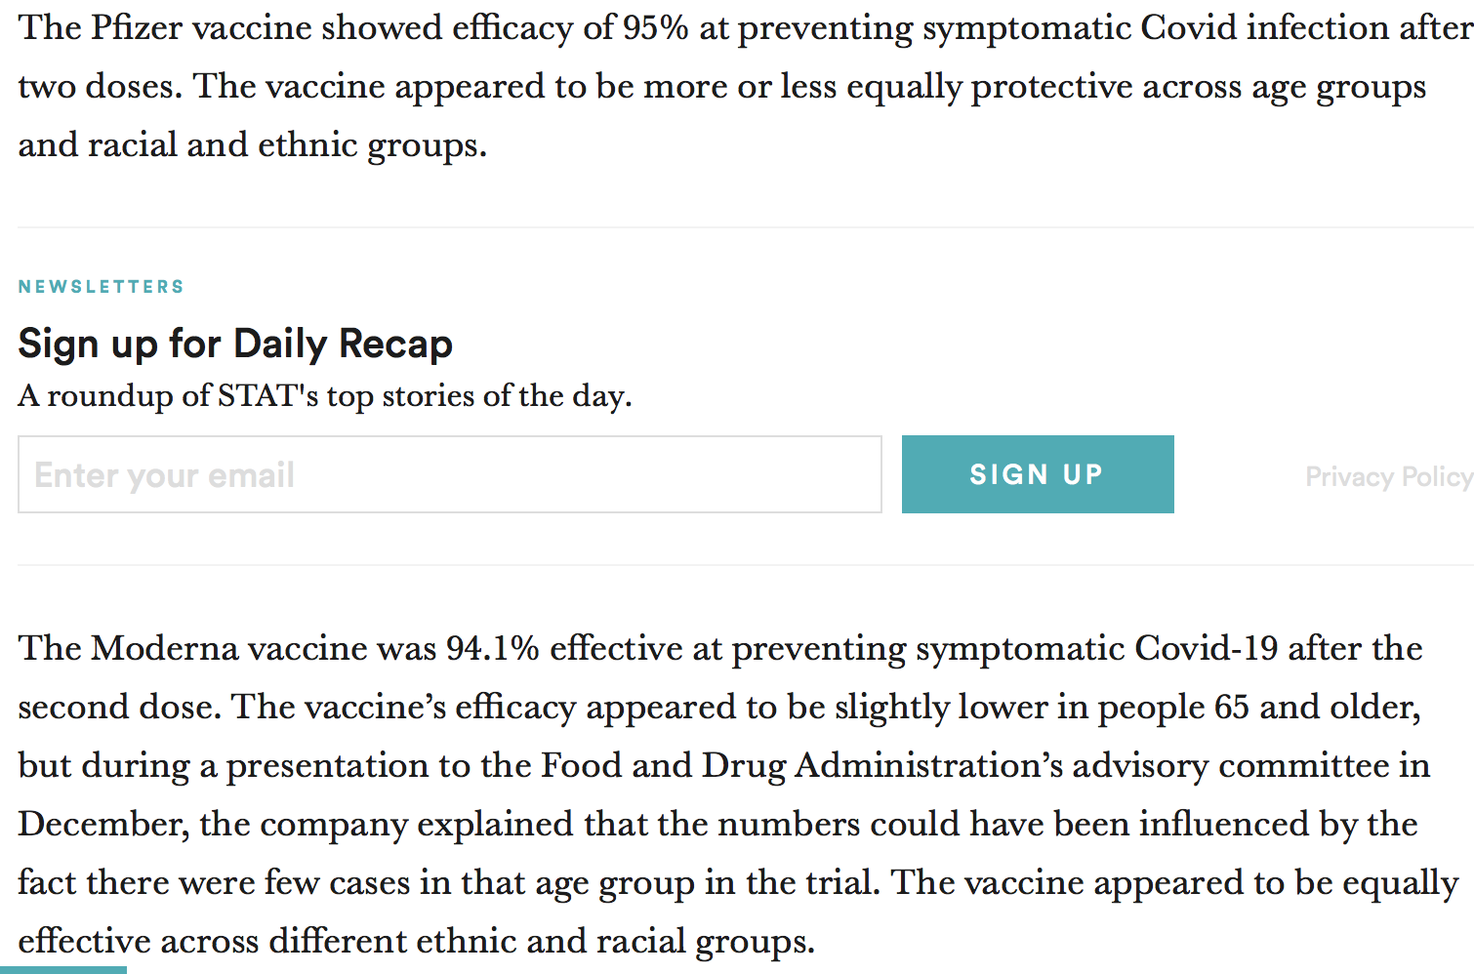
Notes:
Has nothing to do with investing, but clearly culd have made that differe ce

Slide 42
ModeRNA?
Notes:
Uses mrna to make drugs
Ceo- stephane bancel?

Slide 43
Notes:
https://investors.modernatx.com/static-files/d427592c-dab4-4715-a568-31207d9832ab
“Modified RNA”
High rev (mostly vaccine)

Slide 44
qualitative
Generating profit from vaccines and also focusing on children:
Notes:
Competitors business model strategy leader

Slide 45
Products
• Moderna COVID-19 Vaccine/SpikevaxTM: Final blinded analysis of Phase 3 COVE study shows 93% efficacy; Efficacy remains durable through six months after second dose
Many Drugs in progress:
Quadrivalent seasonal flu vaccine (mRNA-1010): Started Phase 1/2 study
RSV vaccine (mRNA-1345): Received Fast Track designation from the FDA in adults older than 60 years of age
Zika vaccine (mRNA-1893): Started Phase 2 study
PA rare disease program (mRNA-3927): Started Phase 1/2 study in patients
IL-2 auto-immune disease program (mRNA-6231): Started Phase 1 study in healthy volunteers
Notes:
Keywords : Efficacy (might be green)
Many drugs in progress

Slide 46
Investors Presentation
See Corp Resp (44)
See Financials
See highlight page
Notes:
https://investors.modernatx.com/static-files/d427592c-dab4-4715-a568-31207d9832ab

Slide 47
Research number of orders from diff countries
-> no successful market drug until now
-> issues w/ CEO and personality?
Notes:
Important to do research
Not u

Slide 48
Cons
-> no successful market drug until now
-> issues w/ CEO and personality?
-> where it gets its cells? (some HC uses aborted fetus/some no)
Notes:
Important to do research
Not u

Slide 49
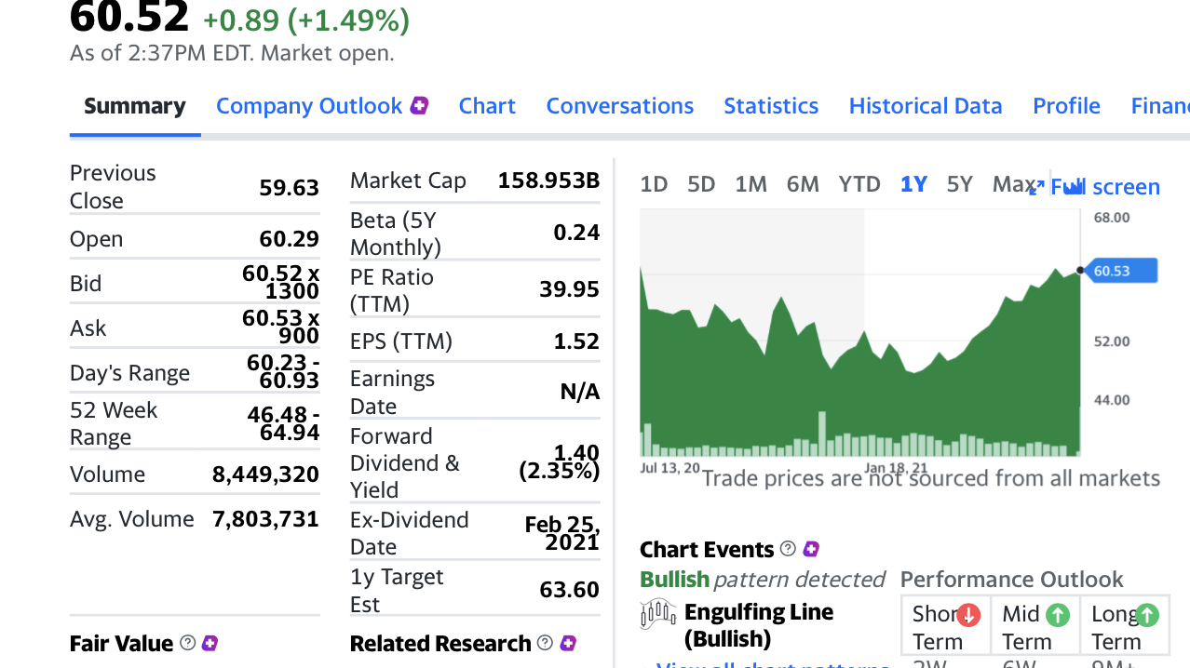

Slide 50
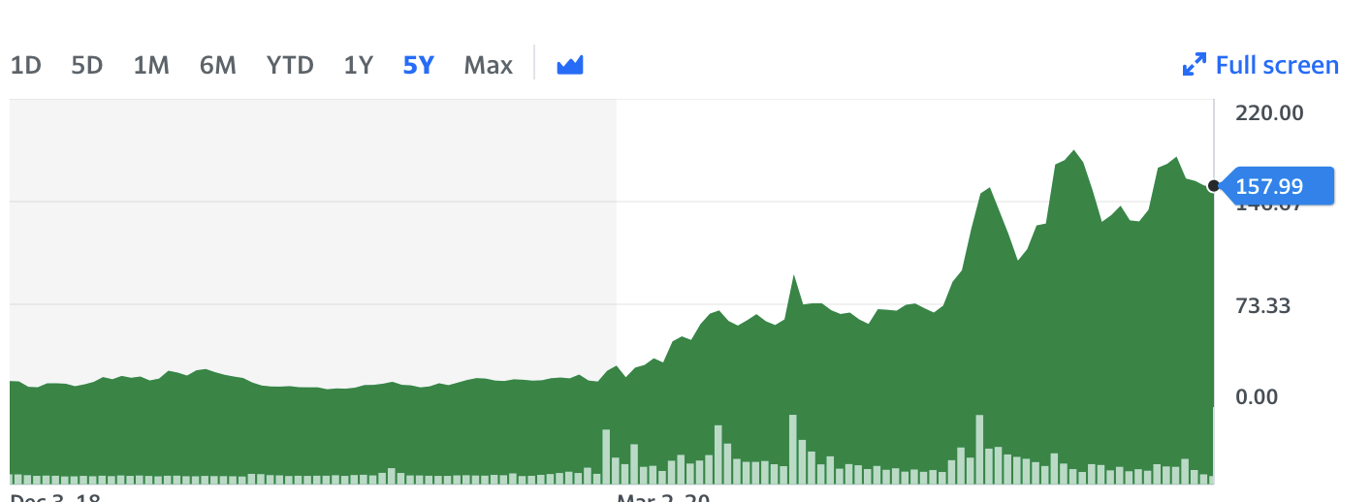
Moderna – Technical Analysis
Notes:
Started out at 30 rose to 157
AZ
Many fluctuations…
Vaccine is mostly effective for kids 12-17
Variants include SA and LA
Working on a vaccine for younger ppl i think

Slide 51
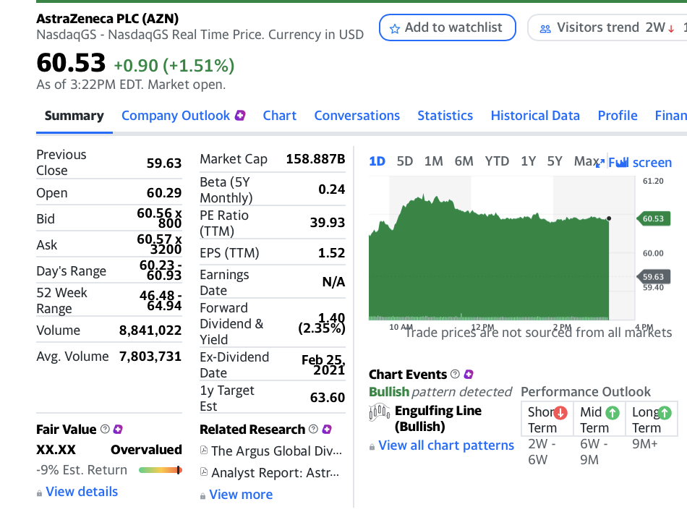
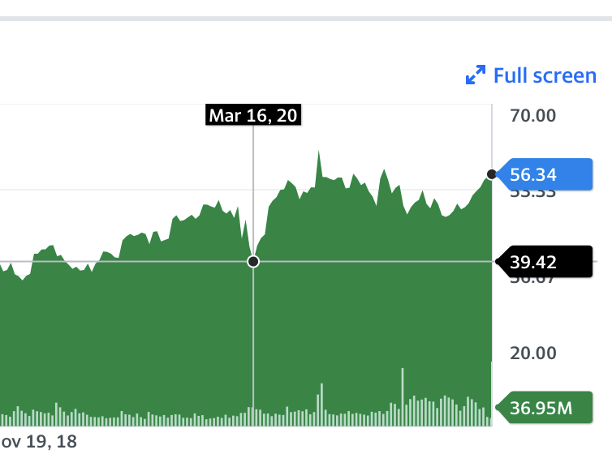
Who didn’t?
AstraZeneca
Notes:
Others: cytodyn, gilead sci (prices did not change significantly)
76% efficacy if possible
British-swedish company
Known for working on vrarois fields (immunoc..) but esp the vaccine

Slide 52
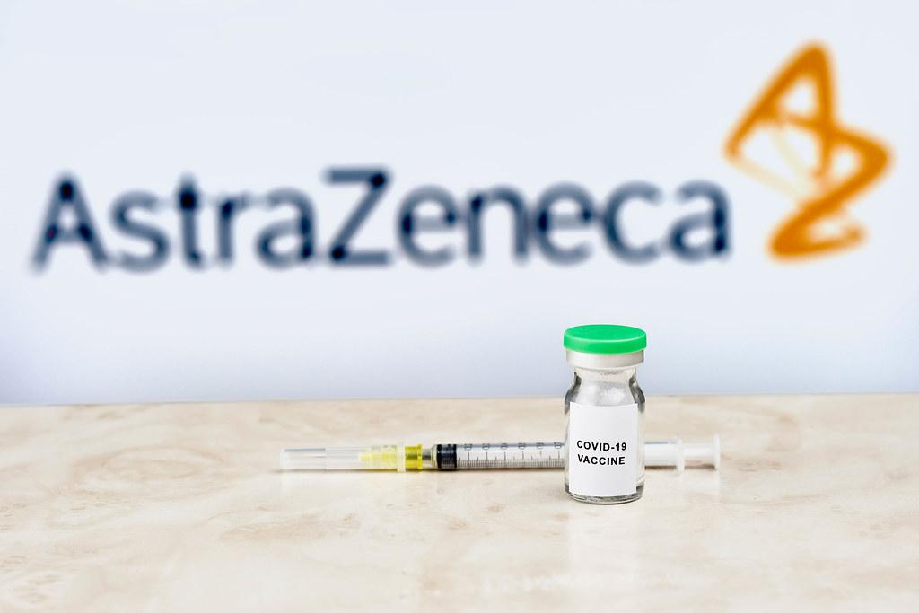
Notes:
https://www.astrazeneca.com/content/dam/az/PDF/2021/h1-2021/H1_2021_results_presentation.pdf

Slide 53
Notes:
FIRST TWO 0- speaks to competition (it is leading with r&d)
Business model is successful (many projects in phase III - last stage of trial)

Slide 54
TIME Permitting
https://www.youtube.com/watch?v=AJK-DX9iZ8g
Notes:
Whod you trust more?

Slide 55
Difference between biotech and pharm?

Slide 56
What are any differences from say Mod? (one word)

Slide 57
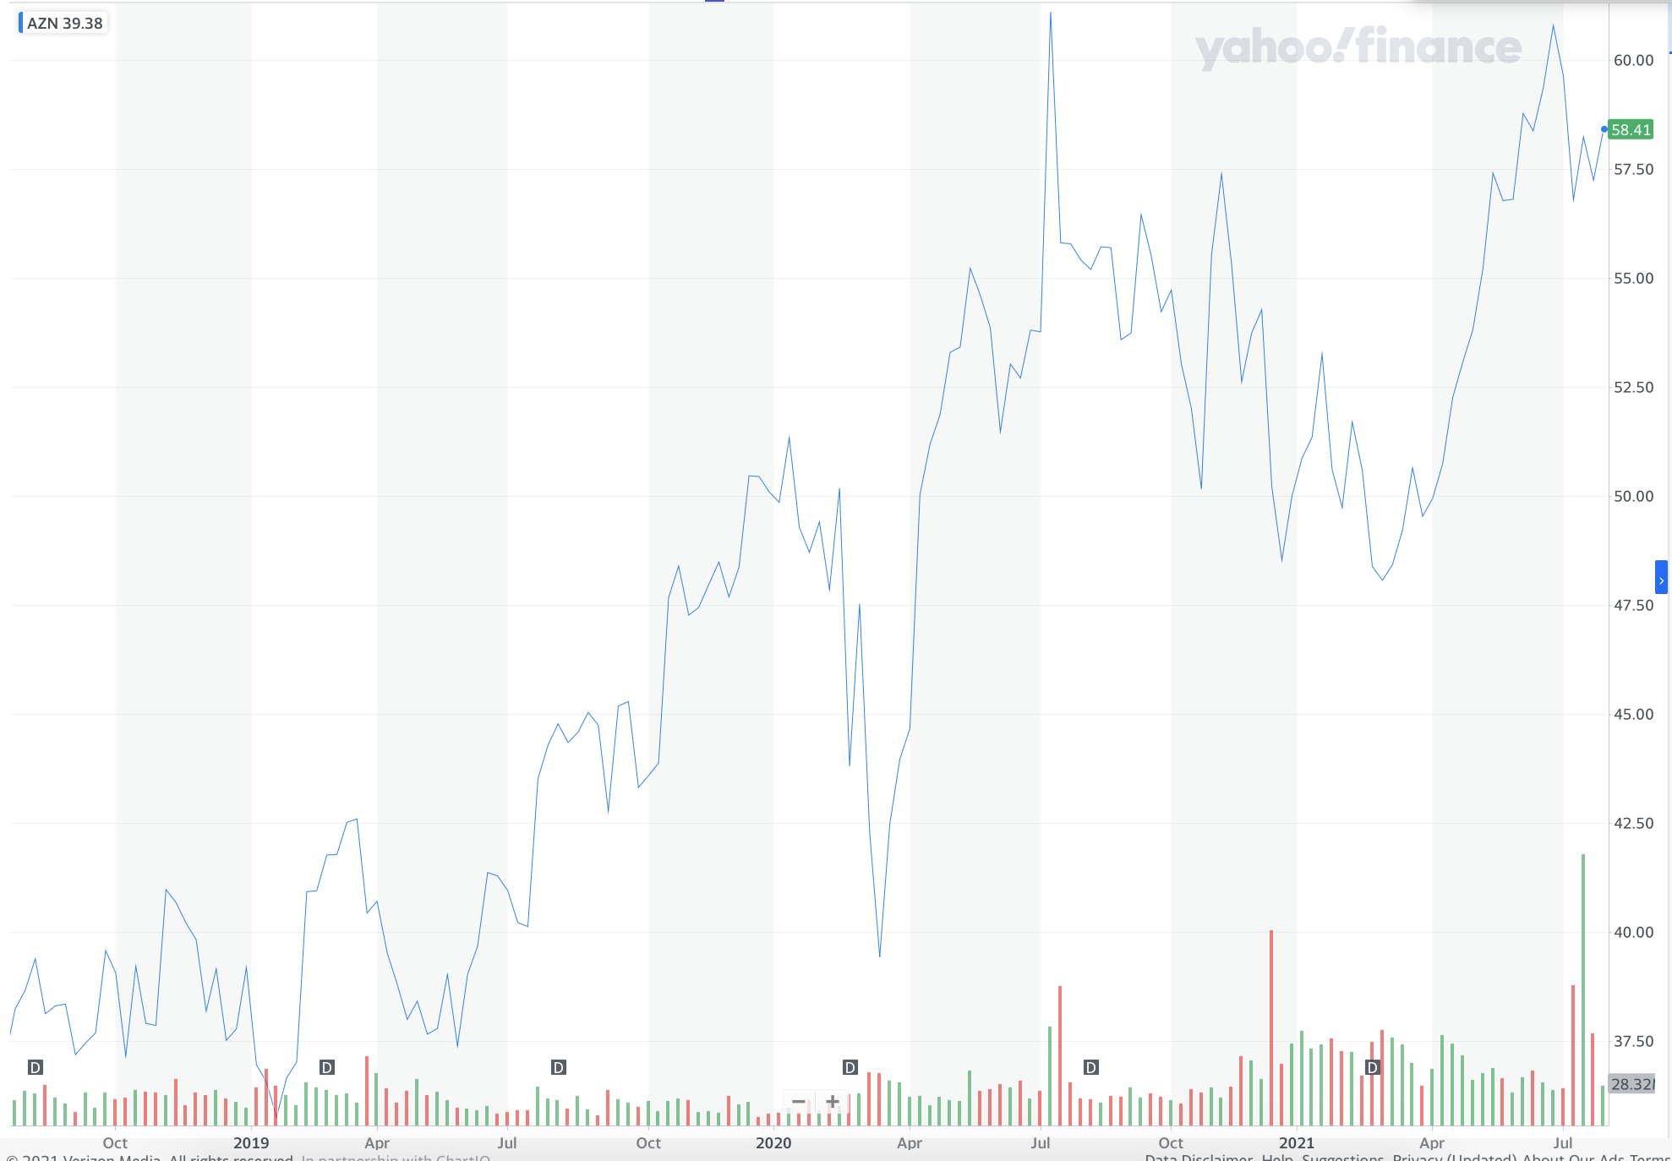
technicals
AstraZeneca
Notes:
200%
Not much price movt - rly important
Others: cytodyn, gilead sci (prices did not change significantly)
76% efficacy if possible
British-swedish company
Known for working on vrarois fields (immunoc..) but esp the vaccine

Slide 58
Pros and Cons
Upwards revenue
Sales from drugs (advanced)
Diversity, environment, ….
Conflicts w/ EU/UK
Not as potent as other variants (observation)/
Stock price not moving
Notes:
Pulled from Google search AZ findings
https://www.astrazeneca.com/content/dam/az/PDF/2021/q1-2021/AZ-shareholder-engagement-event-2021.pdf

Slide 59
Takeaways
> Not all companies work together…rely on investor’s money greatly
> Important to research in depth (TECHNICAL AND FUNDAMENTAL)
Not every “vaccine” companies benefited;
*****an ETF might help?
> People invest not just for personal needs, but societal ones!

